Slide 1
Human Activity Recognition
Edwin Candinegara

Slide 2
Objectives
Real-time Smartphone based Human Activity Recognition
Smartwatch based Human Activity Recognition
Notes:
= Data collection process → documentation
= Activity description
Versus available data currentls

Slide 3
Data Collection
14 persons – including myself (7 males, 7 females, 19-24 years old)
Collected Data Summary:
15 activities / person
TOTAL: 539 mins
Name | Duration | Name | Duration | Name | Duration
Edwin | 89 | Nikolas | 45 | Andri | 45
Richsen | 45 | Samuel | 45 | Arianto | 45
Lauren | 45 | Elmo | 45 | Orlin | 45
Shelina | 45 | Monica | 45 | Vina | 45
Mellita | 45 | Inge | 45

Slide 4
Baseline Results

Slide 5
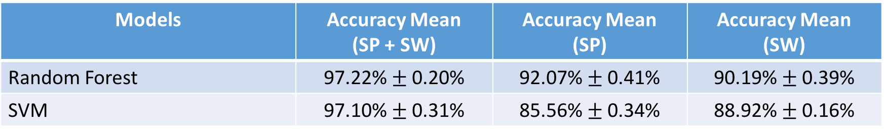
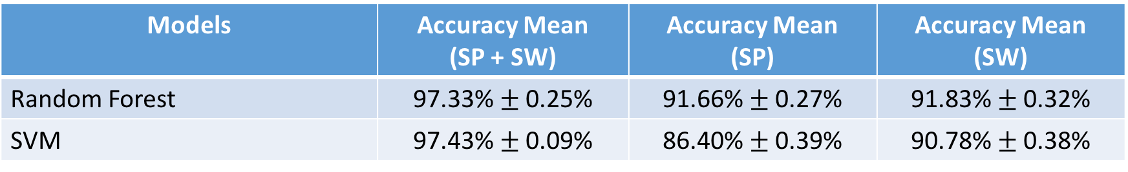
5-Fold CV on Combined Dataset (6 persons)
15 activities, Sampling @ 10 Hz, Window Size = 2s
14 activities (WITHOUT EATING), Sampling @ 10 Hz, Window Size = 2s
Models | Accuracy Mean (SP + SW) | Accuracy Mean (SP) | Accuracy Mean (SW)
Random Forest | 97.22% $±$ 0.20% | 92.07% $±$ 0.41% | 90.19% $±$ 0.39%
SVM | 97.10% $±$ 0.31% | 85.56% $±$ 0.34% | 88.92% $±$ 0.16%
Models | Accuracy Mean (SP + SW) | Accuracy Mean (SP) | Accuracy Mean (SW)
Random Forest | 97.33% $±$ 0.25% | 91.66% $±$ 0.27% | 91.83% $±$ 0.32%
SVM | 97.43% $±$ 0.09% | 86.40% $±$ 0.39% | 90.78% $±$ 0.38%

Slide 6
7 Persons Results

Slide 7
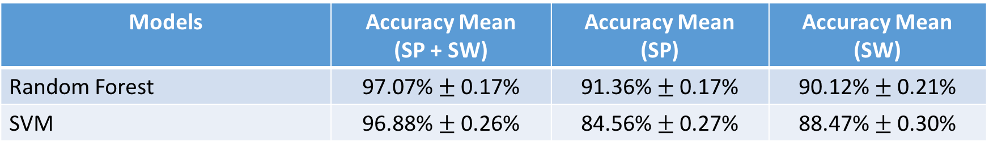
5-Fold CV on Combined Dataset (7 persons)
15 activities, Sampling @ 10 Hz, Window size = 2s
Comparison → 15 activities, 6 Persons results:
Models | Accuracy Mean (SP + SW) | Accuracy Mean (SP) | Accuracy Mean (SW)
Random Forest | 97.07% $±$ 0.17% | 91.36% $±$ 0.17% | 90.12% $±$ 0.21%
SVM | 96.88% $±$ 0.26% | 84.56% $±$ 0.27% | 88.47% $±$ 0.30%
Models | Accuracy Mean (SP + SW) | Accuracy Mean (SP) | Accuracy Mean (SW)
Random Forest | 97.22% $±$ 0.20% | 92.07% $±$ 0.41% | 90.19% $±$ 0.39%
SVM | 97.10% $±$ 0.31% | 85.56% $±$ 0.34% | 88.92% $±$ 0.16%

Slide 8
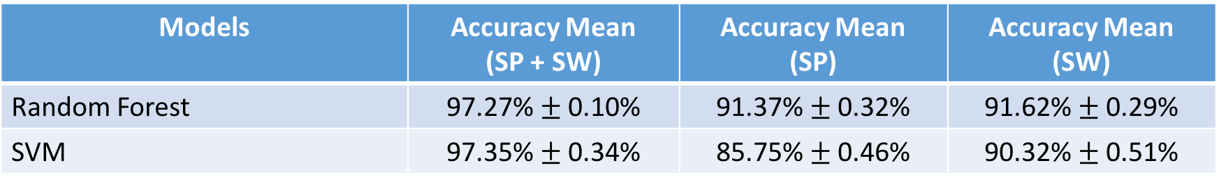
5-Fold CV on Combined Dataset (7 persons)
14 activities (WITHOUT EATING), Sampling @ 10 Hz, Window size = 2s
Comparison → 14 activities (WITHOUT EATING), 6 Persons results:
Models | Accuracy Mean (SP + SW) | Accuracy Mean (SP) | Accuracy Mean (SW)
Random Forest | 97.27% $±$ 0.10% | 91.37% $±$ 0.32% | 91.62% $±$ 0.29%
SVM | 97.35% $±$ 0.34% | 85.75% $±$ 0.46% | 90.32% $±$ 0.51%
Models | Accuracy Mean (SP + SW) | Accuracy Mean (SP) | Accuracy Mean (SW)
Random Forest | 97.33% $±$ 0.25% | 91.66% $±$ 0.27% | 91.83% $±$ 0.32%
SVM | 97.43% $±$ 0.09% | 86.40% $±$ 0.39% | 90.78% $±$ 0.38%

Slide 9
8 Persons Results

Slide 10
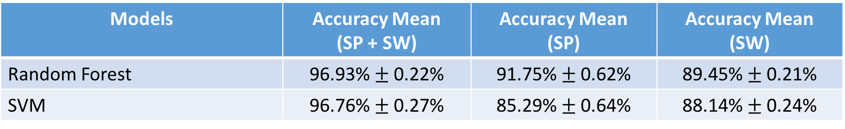
5-Fold CV on Combined Dataset (8 persons)
15 activities, Sampling @ 10 Hz, Window size = 2s
Comparison → 15 activities, 6 Persons results:
Models | Accuracy Mean (SP + SW) | Accuracy Mean (SP) | Accuracy Mean (SW)
Random Forest | 96.93% $±$ 0.22% | 91.75% $±$ 0.62% | 89.45% $±$ 0.21%
SVM | 96.76% $±$ 0.27% | 85.29% $±$ 0.64% | 88.14% $±$ 0.24%
Models | Accuracy Mean (SP + SW) | Accuracy Mean (SP) | Accuracy Mean (SW)
Random Forest | 97.22% $±$ 0.20% | 92.07% $±$ 0.41% | 90.19% $±$ 0.39%
SVM | 97.10% $±$ 0.31% | 85.56% $±$ 0.34% | 88.92% $±$ 0.16%

Slide 11
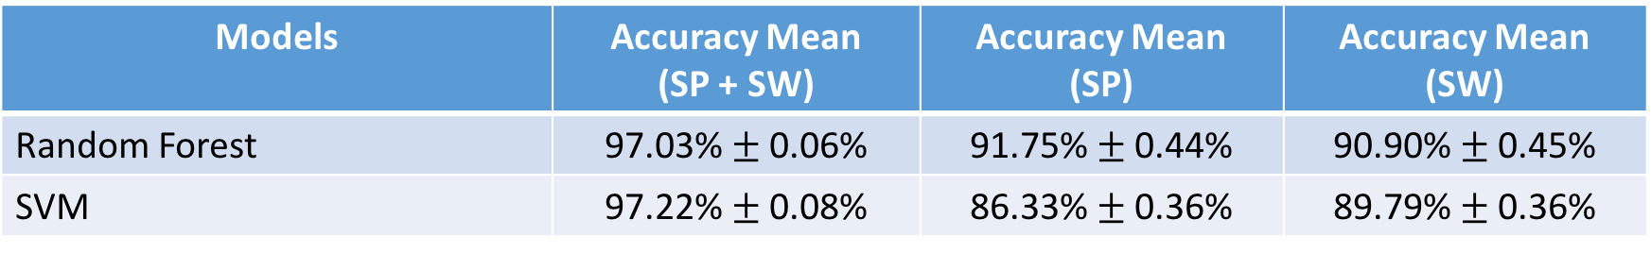
5-Fold CV on Combined Dataset (8 persons)
14 activities (WITHOUT EATING), Sampling @ 10 Hz, Window size = 2s
Comparison → 14 activities (WITHOUT EATING), 6 Persons results:
Models | Accuracy Mean (SP + SW) | Accuracy Mean (SP) | Accuracy Mean (SW)
Random Forest | 97.03% $±$ 0.06% | 91.75% $±$ 0.44% | 90.90% $±$ 0.45%
SVM | 97.22% $±$ 0.08% | 86.33% $±$ 0.36% | 89.79% $±$ 0.36%
Models | Accuracy Mean (SP + SW) | Accuracy Mean (SP) | Accuracy Mean (SW)
Random Forest | 97.33% $±$ 0.25% | 91.66% $±$ 0.27% | 91.83% $±$ 0.32%
SVM | 97.43% $±$ 0.09% | 86.40% $±$ 0.39% | 90.78% $±$ 0.38%

Slide 12
10 Persons Results

Slide 13
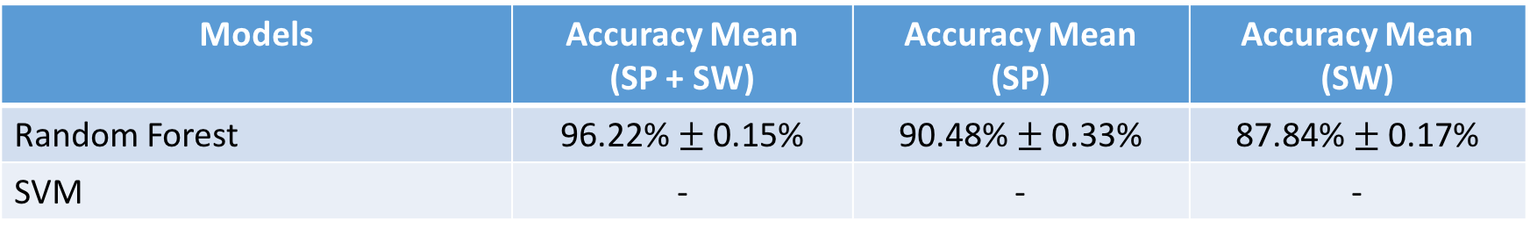
5-Fold CV on Combined Dataset (10 persons)
14 activities (WITHOUT EATING), Sampling @ 10 Hz, Window size = 2s
Comparison → 14 activities (WITHOUT EATING), 6 Persons results:
Models | Accuracy Mean (SP + SW) | Accuracy Mean (SP) | Accuracy Mean (SW)
Random Forest | 96.22% $±$ 0.15% | 90.48% $±$ 0.33% | 87.84% $±$ 0.17%
SVM | - | - | -
Models | Accuracy Mean (SP + SW) | Accuracy Mean (SP) | Accuracy Mean (SW)
Random Forest | 97.33% $±$ 0.25% | 91.66% $±$ 0.27% | 91.83% $±$ 0.32%
SVM | 97.43% $±$ 0.09% | 86.40% $±$ 0.39% | 90.78% $±$ 0.38%

Slide 14
11 Persons Results

Slide 15

5-Fold CV on Combined Dataset (11 persons)
14 activities (WITHOUT EATING), Sampling @ 10 Hz, Window size = 2s
Comparison → 14 activities (WITHOUT EATING), 6 Persons results:
Models | Accuracy Mean (SP + SW) | Accuracy Mean (SP) | Accuracy Mean (SW)
Random Forest | 96.25% $±$ 0.24% | 90.31% $±$ 0.34% | 88.68% $±$ 0.22%
SVM | 96.12% $±$ 0.25% | 82.68% $±$ 0.75% | 87.53% $±$ 0.23%
Models | Accuracy Mean (SP + SW) | Accuracy Mean (SP) | Accuracy Mean (SW)
Random Forest | 97.33% $±$ 0.25% | 91.66% $±$ 0.27% | 91.83% $±$ 0.32%
SVM | 97.43% $±$ 0.09% | 86.40% $±$ 0.39% | 90.78% $±$ 0.38%

Slide 16
11 Persons Results

Slide 17
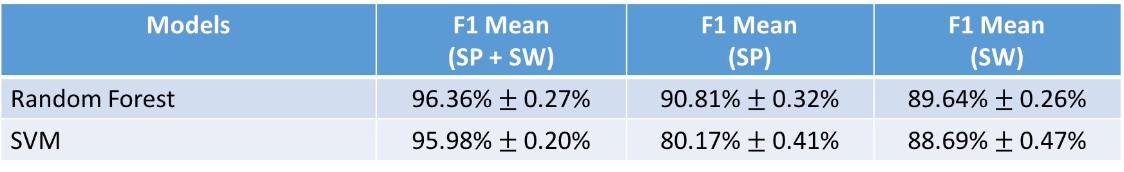
5-Fold CV on Combined Dataset (11 persons)
14 activities (WITHOUT EATING), Sampling @ 10 Hz, Window size = 2s
Comparison → 14 activities (WITHOUT EATING), 6 Persons results:
Models | F1 Mean (SP + SW) | F1 Mean (SP) | F1 Mean (SW)
Random Forest | 96.36% $±$ 0.27% | 90.81% $±$ 0.32% | 89.64% $±$ 0.26%
SVM | 95.98% $±$ 0.20% | 80.17% $±$ 0.41% | 88.69% $±$ 0.47%
Models | Accuracy Mean (SP + SW) | Accuracy Mean (SP) | Accuracy Mean (SW)
Random Forest | 97.33% $±$ 0.25% | 91.66% $±$ 0.27% | 91.83% $±$ 0.32%
SVM | 97.43% $±$ 0.09% | 86.40% $±$ 0.39% | 90.78% $±$ 0.38%

Slide 18
Leave One Out CV

Slide 19
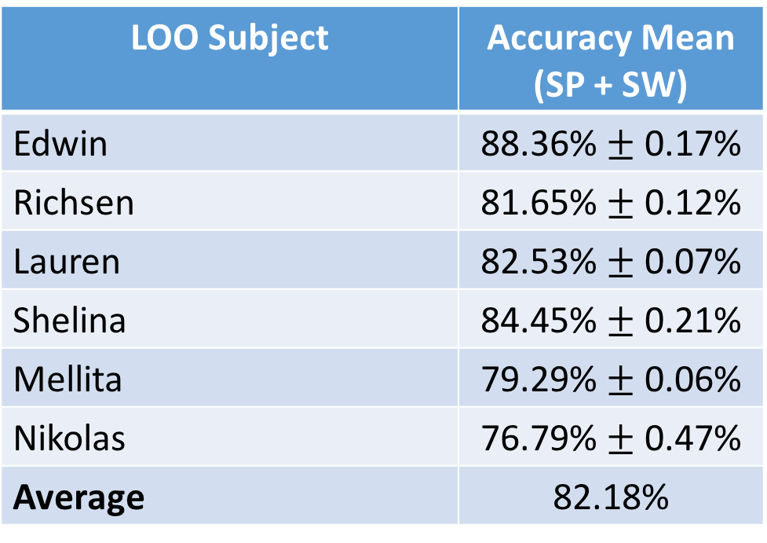
LOO (BASELINE 6 PERSONS)
14 Activities (without Eating)
Random Forest → 2000 estimators, 3 times per subject
LOO Subject | Accuracy Mean (SP + SW)
Edwin | 88.36% $±$ 0.17%
Richsen | 81.65% $±$ 0.12%
Lauren | 82.53% $±$ 0.07%
Shelina | 84.45% $±$ 0.21%
Mellita | 79.29% $±$ 0.06%
Nikolas | 76.79% $±$ 0.47%
Average | 82.18%

Slide 20
LOO 7 PERSONS

Slide 21
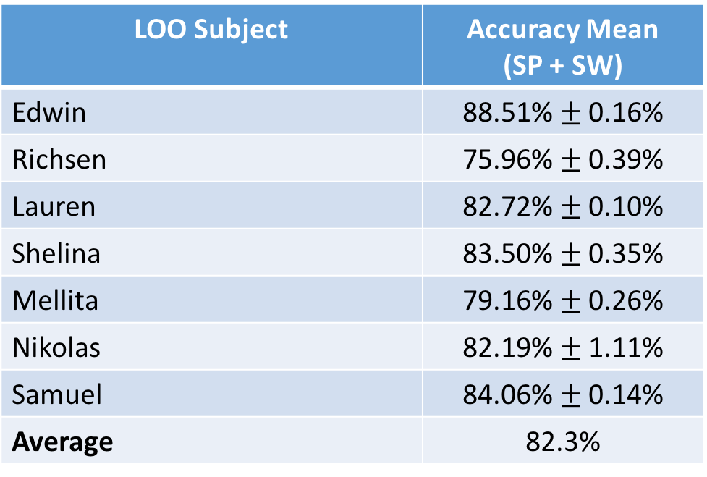
LOO (7 PERSONS)
14 Activities (without Eating)
Random Forest → 500 estimators, 3 times per subject
LOO Subject | Accuracy Mean (SP + SW)
Edwin | 88.51% $±$ 0.16%
Richsen | 75.96% $±$ 0.39%
Lauren | 82.72% $±$ 0.10%
Shelina | 83.50% $±$ 0.35%
Mellita | 79.16% $±$ 0.26%
Nikolas | 82.19% $±$ 1.11%
Samuel | 84.06% $±$ 0.14%
Average | 82.3%

Slide 22
LOO 8 PERSONS

Slide 23
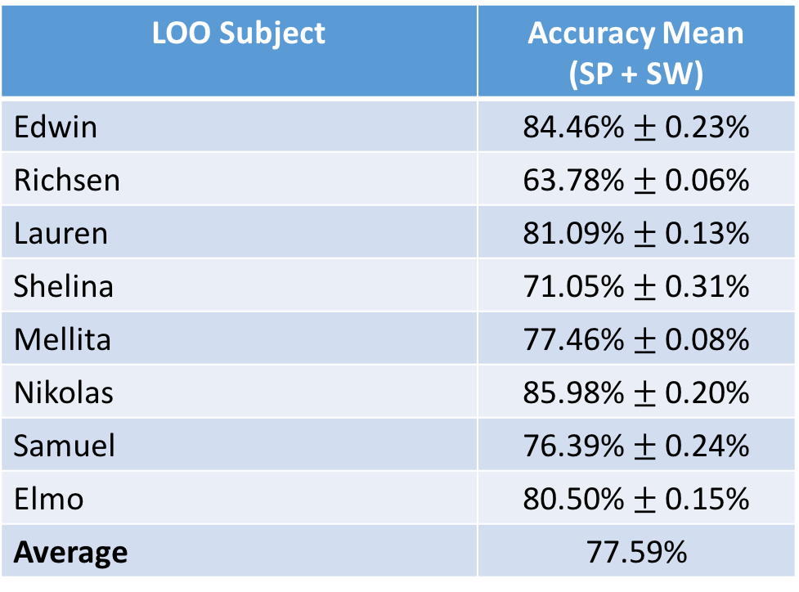
LOO (8 PERSONS)
15 Activities
Random Forest → 500 estimators, 3 times per subject
LOO Subject | Accuracy Mean (SP + SW)
Edwin | 84.46% $±$ 0.23%
Richsen | 63.78% $±$ 0.06%
Lauren | 81.09% $±$ 0.13%
Shelina | 71.05% $±$ 0.31%
Mellita | 77.46% $±$ 0.08%
Nikolas | 85.98% $±$ 0.20%
Samuel | 76.39% $±$ 0.24%
Elmo | 80.50% $±$ 0.15%
Average | 77.59%

Slide 24
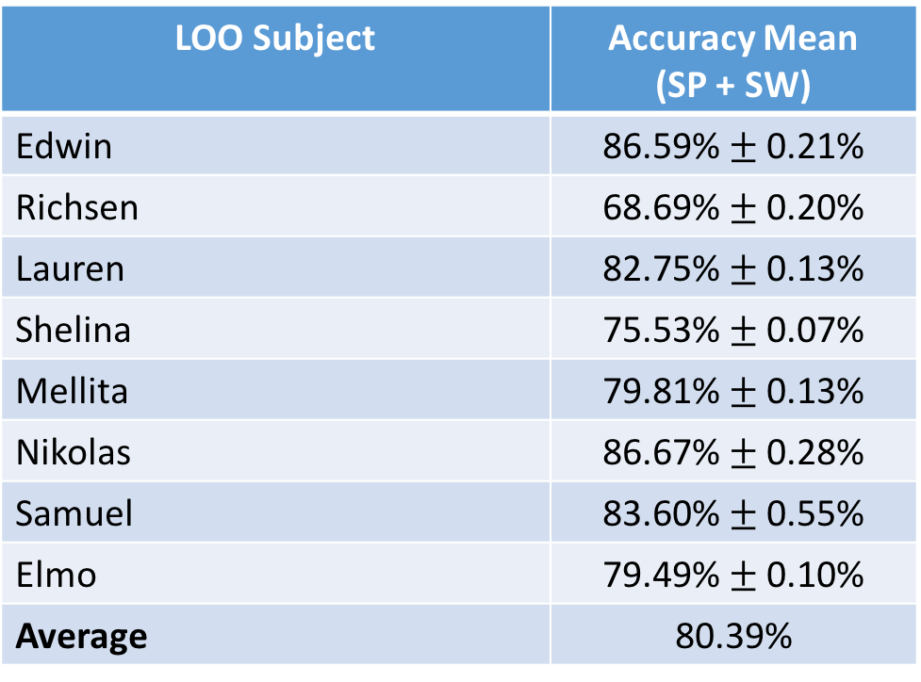
LOO (8 PERSONS)
14 Activities (without Eating)
Random Forest → 500 estimators, 3 times per subject
LOO Subject | Accuracy Mean (SP + SW)
Edwin | 86.59% $±$ 0.21%
Richsen | 68.69% $±$ 0.20%
Lauren | 82.75% $±$ 0.13%
Shelina | 75.53% $±$ 0.07%
Mellita | 79.81% $±$ 0.13%
Nikolas | 86.67% $±$ 0.28%
Samuel | 83.60% $±$ 0.55%
Elmo | 79.49% $±$ 0.10%
Average | 80.39%

Slide 25
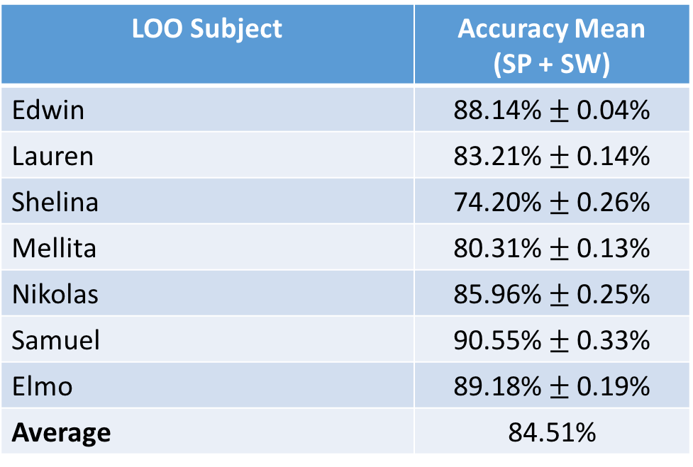
LOO (7 PERSONS – without Richsen) - RF
14 Activities (without Eating)
Random Forest → 500 estimators, 3 times per subject
LOO Subject | Accuracy Mean (SP + SW)
Edwin | 88.14% $±$ 0.04%
Lauren | 83.21% $±$ 0.14%
Shelina | 74.20% $±$ 0.26%
Mellita | 80.31% $±$ 0.13%
Nikolas | 85.96% $±$ 0.25%
Samuel | 90.55% $±$ 0.33%
Elmo | 89.18% $±$ 0.19%
Average | 84.51%

Slide 26
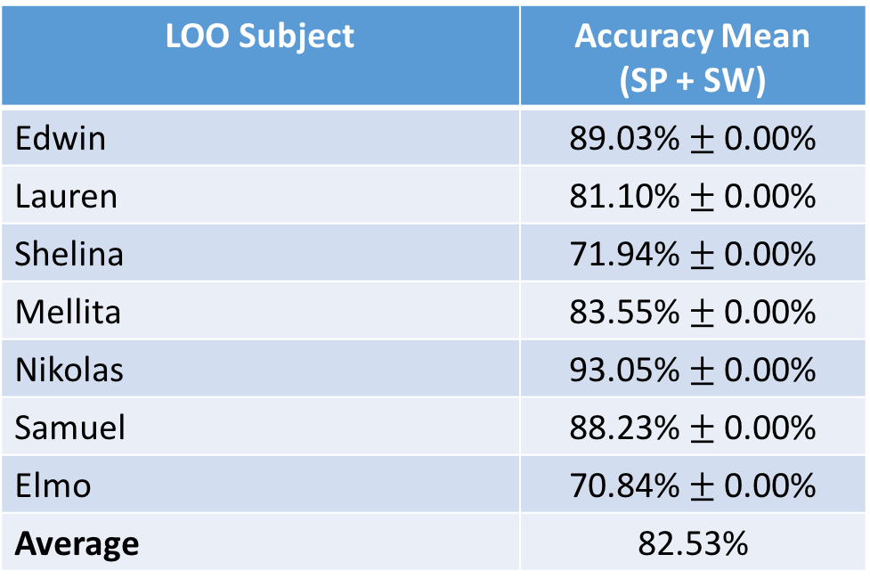
LOO (7 PERSONS – without Richsen) - SVM
14 Activities (without Eating)
SVM → C = 1, Gamma = 0.5, 3 times per subject
LOO Subject | Accuracy Mean (SP + SW)
Edwin | 89.03% $±$ 0.00%
Lauren | 81.10% $±$ 0.00%
Shelina | 71.94% $±$ 0.00%
Mellita | 83.55% $±$ 0.00%
Nikolas | 93.05% $±$ 0.00%
Samuel | 88.23% $±$ 0.00%
Elmo | 70.84% $±$ 0.00%
Average | 82.53%

Slide 27
LOO 10 PERSONS

Slide 28
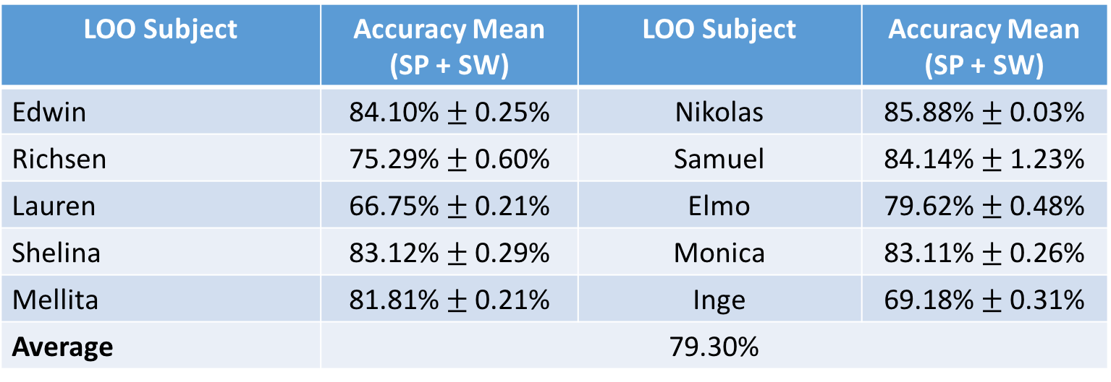
LOO (10 PERSONS)
14 Activities (without Eating)
RF→ Number of Estimators = 500
LOO Subject | Accuracy Mean (SP + SW) | LOO Subject | Accuracy Mean (SP + SW)
Edwin | 84.10% $±$ 0.25% | Nikolas | 85.88% $±$ 0.03%
Richsen | 75.29% $±$ 0.60% | Samuel | 84.14% $±$ 1.23%
Lauren | 66.75% $±$ 0.21% | Elmo | 79.62% $±$ 0.48%
Shelina | 83.12% $±$ 0.29% | Monica | 83.11% $±$ 0.26%
Mellita | 81.81% $±$ 0.21% | Inge | 69.18% $±$ 0.31%
Average | 79.30%

Slide 29
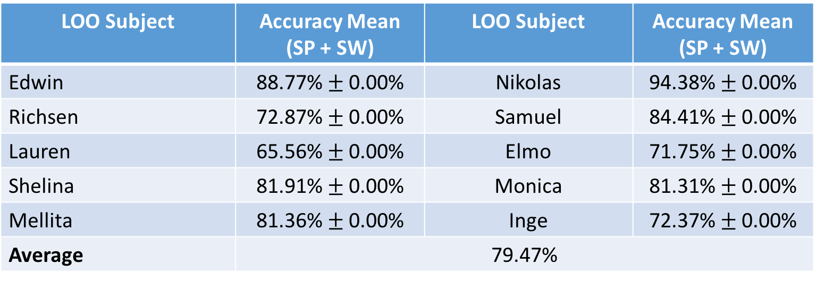
LOO (10 PERSONS)
14 Activities (without Eating)
RF→ Number of Estimators = 500
LOO Subject | Accuracy Mean (SP + SW) | LOO Subject | Accuracy Mean (SP + SW)
Edwin | 88.77% $±$ 0.00% | Nikolas | 94.38% $±$ 0.00%
Richsen | 72.87% $±$ 0.00% | Samuel | 84.41% $±$ 0.00%
Lauren | 65.56% $±$ 0.00% | Elmo | 71.75% $±$ 0.00%
Shelina | 81.91% $±$ 0.00% | Monica | 81.31% $±$ 0.00%
Mellita | 81.36% $±$ 0.00% | Inge | 72.37% $±$ 0.00%
Average | 79.47%

Slide 30
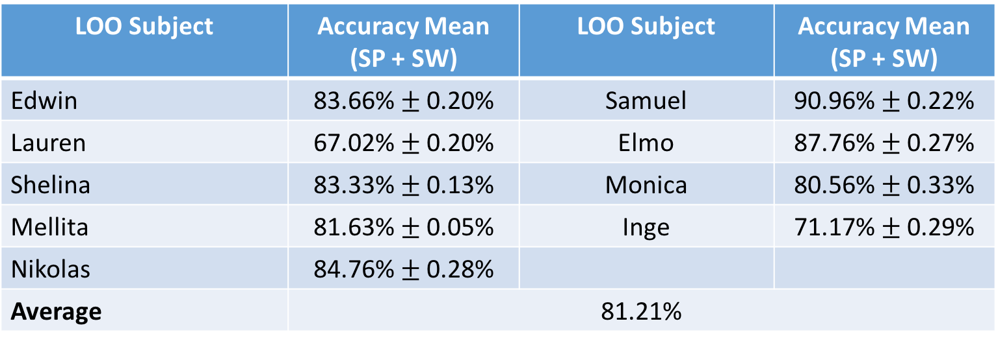
LOO (9 PERSONS) – WITHOUT RICHSEN
14 Activities (without Eating)
RF→ Number of Estimators = 500
LOO Subject | Accuracy Mean (SP + SW) | LOO Subject | Accuracy Mean (SP + SW)
Edwin | 83.66% $±$ 0.20% | Samuel | 90.96% $±$ 0.22%
Lauren | 67.02% $±$ 0.20% | Elmo | 87.76% $±$ 0.27%
Shelina | 83.33% $±$ 0.13% | Monica | 80.56% $±$ 0.33%
Mellita | 81.63% $±$ 0.05% | Inge | 71.17% $±$ 0.29%
Nikolas | 84.76% $±$ 0.28%
Average | 81.21%

Slide 31
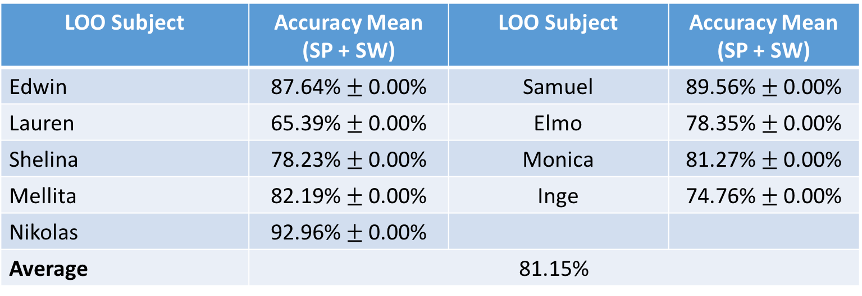
LOO (9 PERSONS) – WITHOUT RICHSEN
14 Activities (without Eating)
SVM → Cost = 1, Gamma = 1
LOO Subject | Accuracy Mean (SP + SW) | LOO Subject | Accuracy Mean (SP + SW)
Edwin | 87.64% $±$ 0.00% | Samuel | 89.56% $±$ 0.00%
Lauren | 65.39% $±$ 0.00% | Elmo | 78.35% $±$ 0.00%
Shelina | 78.23% $±$ 0.00% | Monica | 81.27% $±$ 0.00%
Mellita | 82.19% $±$ 0.00% | Inge | 74.76% $±$ 0.00%
Nikolas | 92.96% $±$ 0.00%
Average | 81.15%

Slide 32
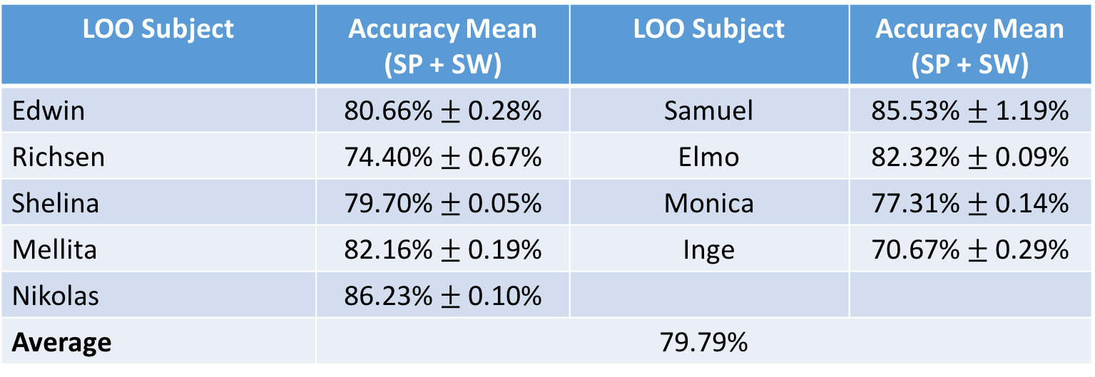
LOO (9 PERSONS) – WITHOUT LAUREN
14 Activities (without Eating)
RF→ Number of Estimators = 500
LOO Subject | Accuracy Mean (SP + SW) | LOO Subject | Accuracy Mean (SP + SW)
Edwin | 80.66% $±$ 0.28% | Samuel | 85.53% $±$ 1.19%
Richsen | 74.40% $±$ 0.67% | Elmo | 82.32% $±$ 0.09%
Shelina | 79.70% $±$ 0.05% | Monica | 77.31% $±$ 0.14%
Mellita | 82.16% $±$ 0.19% | Inge | 70.67% $±$ 0.29%
Nikolas | 86.23% $±$ 0.10%
Average | 79.79%

Slide 33
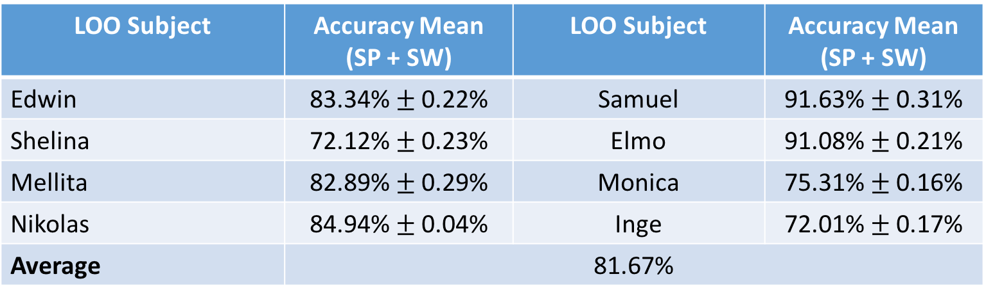
LOO (8 PERSONS) – WITHOUT LAUREN + RICHSEN
14 Activities (without Eating)
RF→ Number of Estimators = 500
LOO Subject | Accuracy Mean (SP + SW) | LOO Subject | Accuracy Mean (SP + SW)
Edwin | 83.34% $±$ 0.22% | Samuel | 91.63% $±$ 0.31%
Shelina | 72.12% $±$ 0.23% | Elmo | 91.08% $±$ 0.21%
Mellita | 82.89% $±$ 0.29% | Monica | 75.31% $±$ 0.16%
Nikolas | 84.94% $±$ 0.04% | Inge | 72.01% $±$ 0.17%
Average | 81.67%

Slide 34
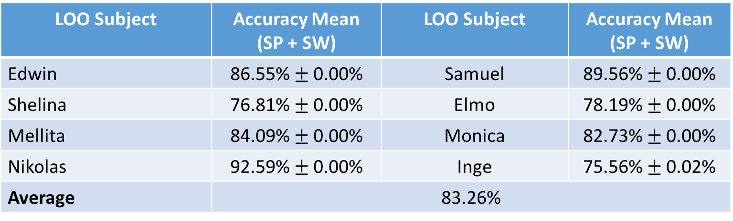
LOO (8 PERSONS) – WITHOUT LAUREN + RICHSEN
14 Activities (without Eating)
SVM → C = 1, Gamma = 0.5
LOO Subject | Accuracy Mean (SP + SW) | LOO Subject | Accuracy Mean (SP + SW)
Edwin | 86.55% $±$ 0.00% | Samuel | 89.56% $±$ 0.00%
Shelina | 76.81% $±$ 0.00% | Elmo | 78.19% $±$ 0.00%
Mellita | 84.09% $±$ 0.00% | Monica | 82.73% $±$ 0.00%
Nikolas | 92.59% $±$ 0.00% | Inge | 75.56% $±$ 0.02%
Average | 83.26%

Slide 35
LOO 11 PERSONS

Slide 36
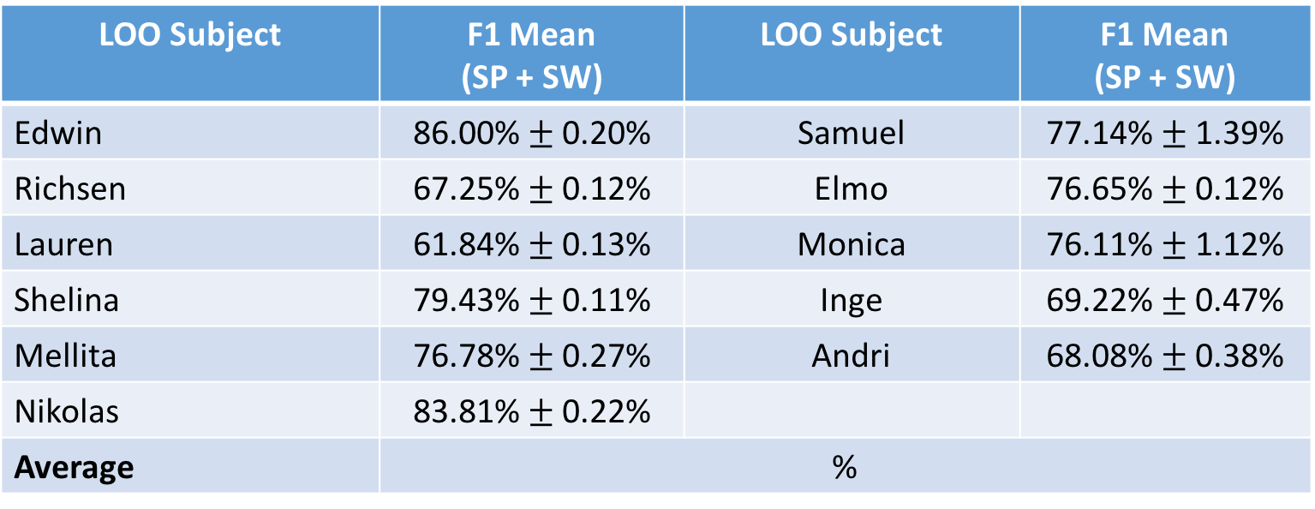
LOO (11 PERSONS)
14 Activities (without Eating)
RF→ Number of Estimators = 500
LOO Subject | F1 Mean (SP + SW) | LOO Subject | F1 Mean (SP + SW)
Edwin | 86.00% $±$ 0.20% | Samuel | 77.14% $±$ 1.39%
Richsen | 67.25% $±$ 0.12% | Elmo | 76.65% $±$ 0.12%
Lauren | 61.84% $±$ 0.13% | Monica | 76.11% $±$ 1.12%
Shelina | 79.43% $±$ 0.11% | Inge | 69.22% $±$ 0.47%
Mellita | 76.78% $±$ 0.27% | Andri | 68.08% $±$ 0.38%
Nikolas | 83.81% $±$ 0.22%
Average | %

Slide 37
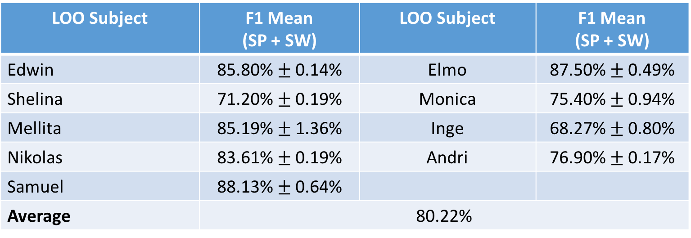
LOO (11 PERSONS) – WITHOUT RICHSEN + LAUREN
14 Activities (without Eating)
RF→ Number of Estimators = 500
LOO Subject | F1 Mean (SP + SW) | LOO Subject | F1 Mean (SP + SW)
Edwin | 85.80% $±$ 0.14% | Elmo | 87.50% $±$ 0.49%
Shelina | 71.20% $±$ 0.19% | Monica | 75.40% $±$ 0.94%
Mellita | 85.19% $±$ 1.36% | Inge | 68.27% $±$ 0.80%
Nikolas | 83.61% $±$ 0.19% | Andri | 76.90% $±$ 0.17%
Samuel | 88.13% $±$ 0.64%
Average | 80.22%

Slide 38
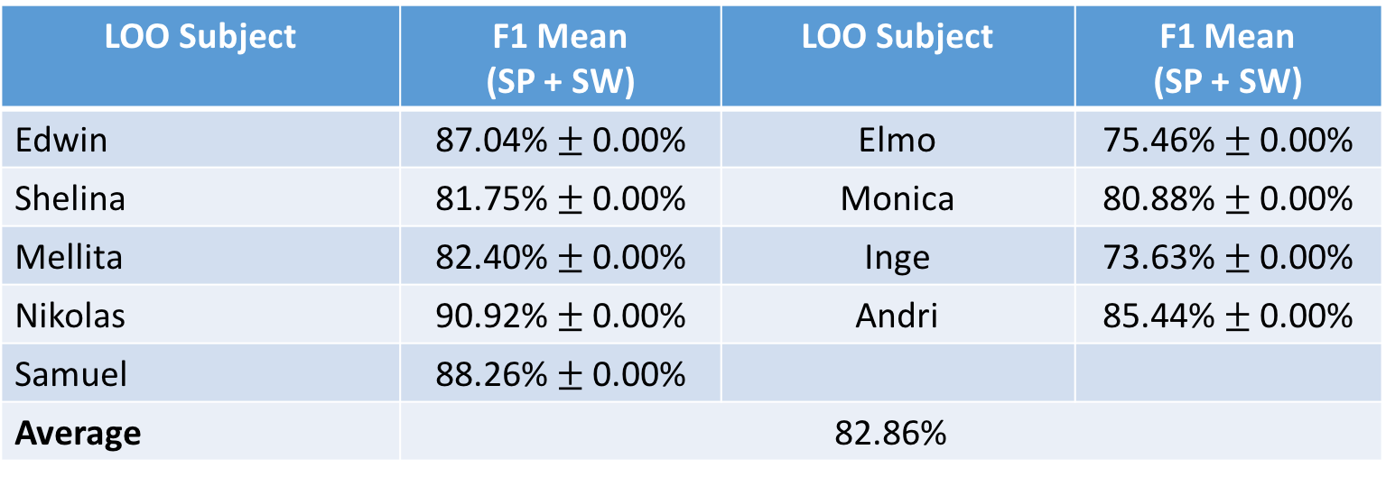
LOO (11 PERSONS) – NO RICHSEN + LAUREN
14 Activities (without Eating)
SVM → C = 1, Gamma = 0.15
LOO Subject | F1 Mean (SP + SW) | LOO Subject | F1 Mean (SP + SW)
Edwin | 87.04% $±$ 0.00% | Elmo | 75.46% $±$ 0.00%
Shelina | 81.75% $±$ 0.00% | Monica | 80.88% $±$ 0.00%
Mellita | 82.40% $±$ 0.00% | Inge | 73.63% $±$ 0.00%
Nikolas | 90.92% $±$ 0.00% | Andri | 85.44% $±$ 0.00%
Samuel | 88.26% $±$ 0.00%
Average | 82.86%

Slide 39
LOO 11 PERSONS (NEW)

Slide 40
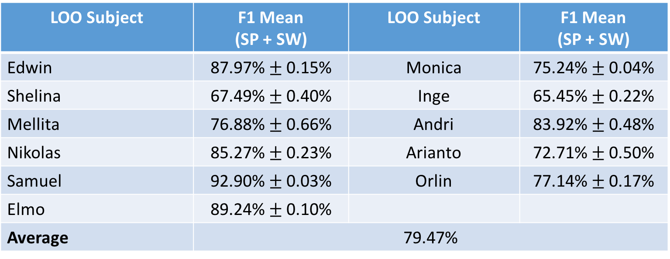
LOO (11 PERSONS)
14 Activities (without Eating)
RF→ Number of Estimators = 500
LOO Subject | F1 Mean (SP + SW) | LOO Subject | F1 Mean (SP + SW)
Edwin | 87.97% $±$ 0.15% | Monica | 75.24% $±$ 0.04%
Shelina | 67.49% $±$ 0.40% | Inge | 65.45% $±$ 0.22%
Mellita | 76.88% $±$ 0.66% | Andri | 83.92% $±$ 0.48%
Nikolas | 85.27% $±$ 0.23% | Arianto | 72.71% $±$ 0.50%
Samuel | 92.90% $±$ 0.03% | Orlin | 77.14% $±$ 0.17%
Elmo | 89.24% $±$ 0.10%
Average | 79.47%

Slide 41
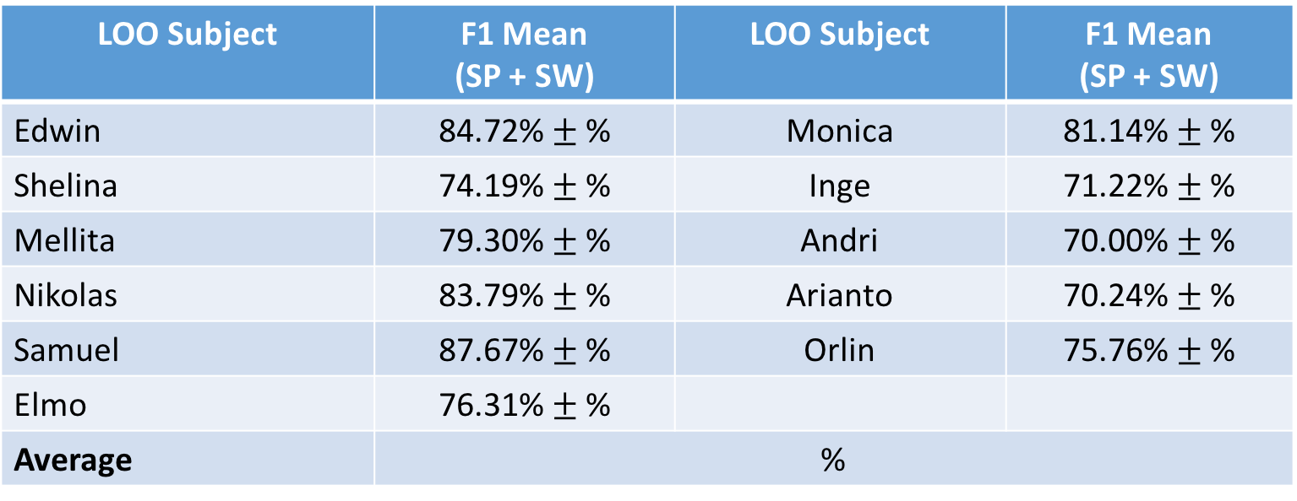
LOO (11 PERSONS)
14 Activities (without Eating)
SVM → C = 1, Gamma = 0.1
LOO Subject | F1 Mean (SP + SW) | LOO Subject | F1 Mean (SP + SW)
Edwin | 84.72% $±$ % | Monica | 81.14% $±$ %
Shelina | 74.19% $±$ % | Inge | 71.22% $±$ %
Mellita | 79.30% $±$ % | Andri | 70.00% $±$ %
Nikolas | 83.79% $±$ % | Arianto | 70.24% $±$ %
Samuel | 87.67% $±$ % | Orlin | 75.76% $±$ %
Elmo | 76.31% $±$ %
Average | %

Slide 42
LOO 12 PERSONS

Slide 43
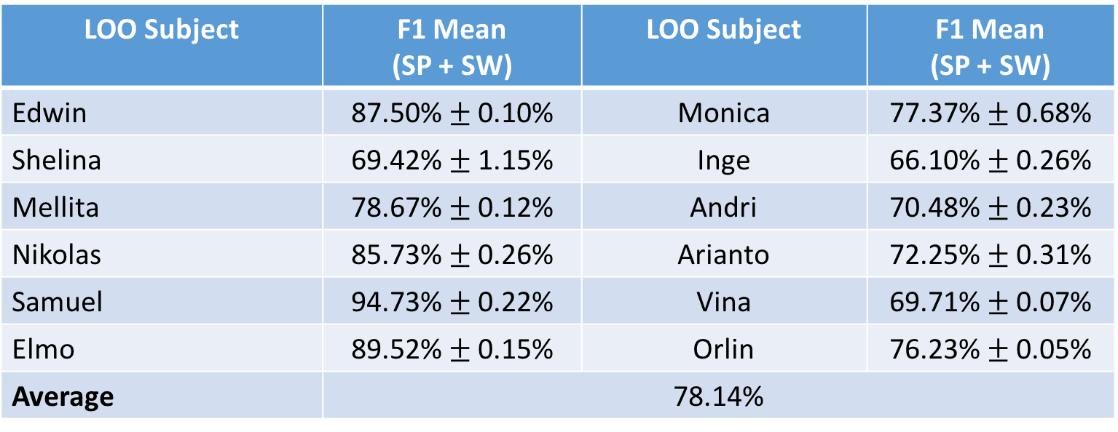
LOO (12 PERSONS)
14 Activities (without Eating)
RF→ Number of Estimators = 500
LOO Subject | F1 Mean (SP + SW) | LOO Subject | F1 Mean (SP + SW)
Edwin | 87.50% $±$ 0.10% | Monica | 77.37% $±$ 0.68%
Shelina | 69.42% $±$ 1.15% | Inge | 66.10% $±$ 0.26%
Mellita | 78.67% $±$ 0.12% | Andri | 70.48% $±$ 0.23%
Nikolas | 85.73% $±$ 0.26% | Arianto | 72.25% $±$ 0.31%
Samuel | 94.73% $±$ 0.22% | Vina | 69.71% $±$ 0.07%
Elmo | 89.52% $±$ 0.15% | Orlin | 76.23% $±$ 0.05%
Average | 78.14%

Slide 44
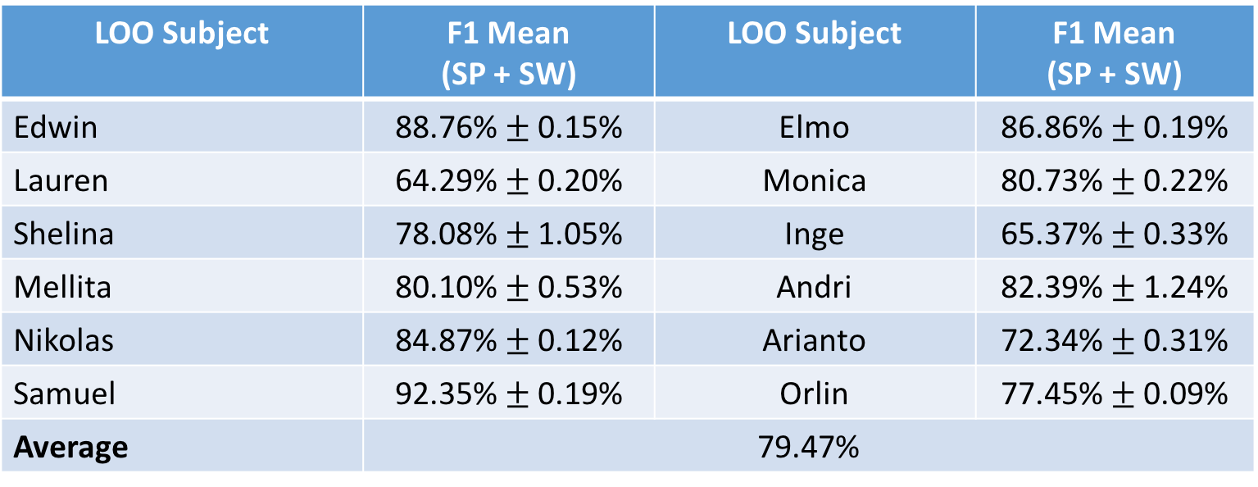
LOO (12 PERSONS)
14 Activities (without Eating)
RF→ Number of Estimators = 500
LOO Subject | F1 Mean (SP + SW) | LOO Subject | F1 Mean (SP + SW)
Edwin | 88.76% $±$ 0.15% | Elmo | 86.86% $±$ 0.19%
Lauren | 64.29% $±$ 0.20% | Monica | 80.73% $±$ 0.22%
Shelina | 78.08% $±$ 1.05% | Inge | 65.37% $±$ 0.33%
Mellita | 80.10% $±$ 0.53% | Andri | 82.39% $±$ 1.24%
Nikolas | 84.87% $±$ 0.12% | Arianto | 72.34% $±$ 0.31%
Samuel | 92.35% $±$ 0.19% | Orlin | 77.45% $±$ 0.09%
Average | 79.47%

Slide 45
LOO 13 PERSONS

Slide 46
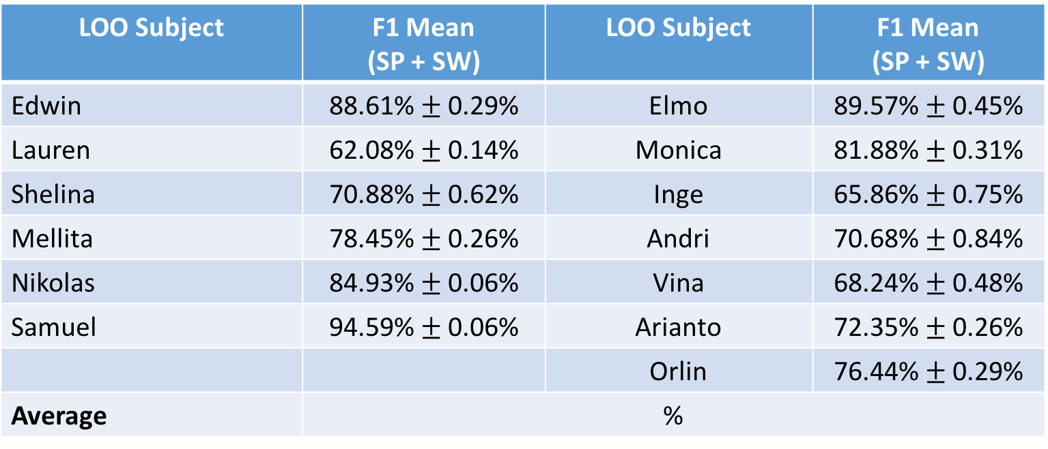
LOO (13 PERSONS)
14 Activities (without Eating)
RF→ Number of Estimators = 500
LOO Subject | F1 Mean (SP + SW) | LOO Subject | F1 Mean (SP + SW)
Edwin | 88.61% $±$ 0.29% | Elmo | 89.57% $±$ 0.45%
Lauren | 62.08% $±$ 0.14% | Monica | 81.88% $±$ 0.31%
Shelina | 70.88% $±$ 0.62% | Inge | 65.86% $±$ 0.75%
Mellita | 78.45% $±$ 0.26% | Andri | 70.68% $±$ 0.84%
Nikolas | 84.93% $±$ 0.06% | Vina | 68.24% $±$ 0.48%
Samuel | 94.59% $±$ 0.06% | Arianto | 72.35% $±$ 0.26%
 |  | Orlin | 76.44% $±$ 0.29%
Average | %

Slide 47
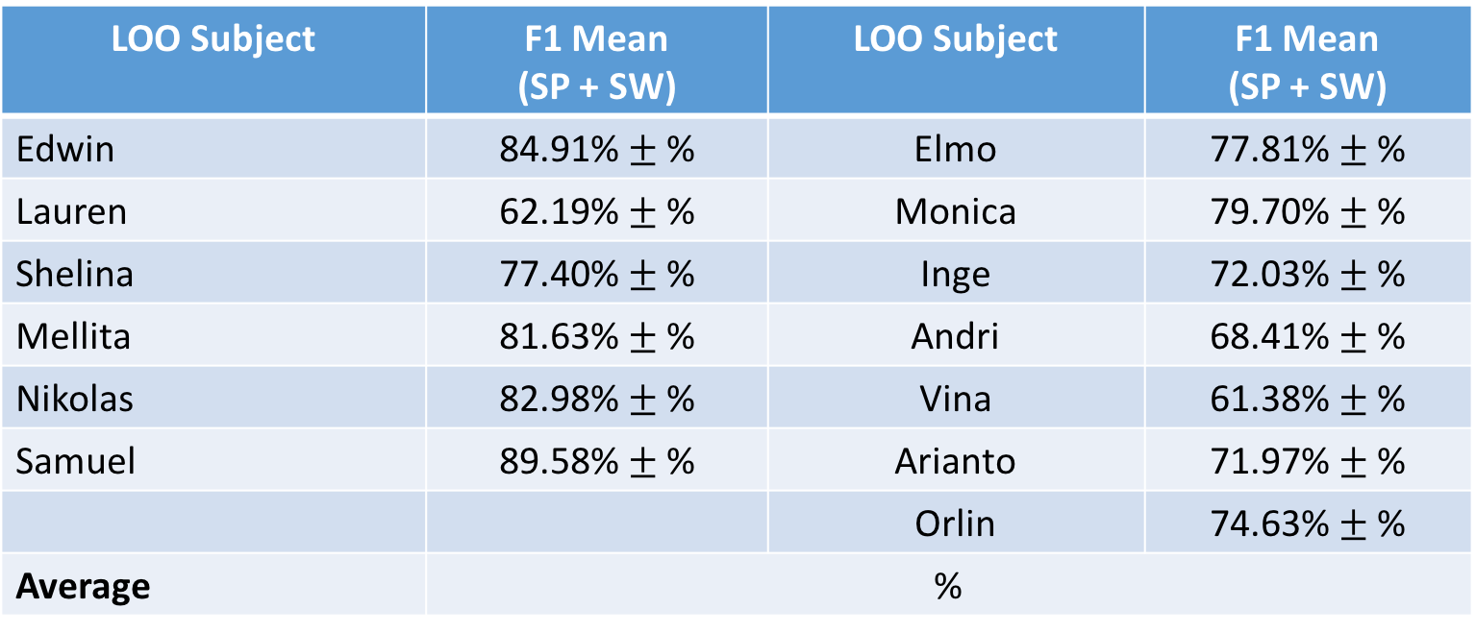
LOO (13 PERSONS)
14 Activities (without Eating)
SVM → C = 1, Gamma = 0.1,
LOO Subject | F1 Mean (SP + SW) | LOO Subject | F1 Mean (SP + SW)
Edwin | 84.91% $±$ % | Elmo | 77.81% $±$ %
Lauren | 62.19% $±$ % | Monica | 79.70% $±$ %
Shelina | 77.40% $±$ % | Inge | 72.03% $±$ %
Mellita | 81.63% $±$ % | Andri | 68.41% $±$ %
Nikolas | 82.98% $±$ % | Vina | 61.38% $±$ %
Samuel | 89.58% $±$ % | Arianto | 71.97% $±$ %
 |  | Orlin | 74.63% $±$ %
Average | %

Slide 48
Other Observations (7 Persons without Richsen)
Typing vs Writing (Lauren)
Lying vs Reading (Elmo, Shelina)
Sitting vs Reading (Mellita, Edwin)
Going downstairs vs Going upstairs vs Walking (Mellita, Elmo, Shelina)
Sitting vs Lying (Nikolas)
Hypothesis:
Probably because of which features are being used in splitting the trees
If we only use SP data, then Lying and Sitting can be recognized
When only use SW data, all Lying becomes Sitting (or the other way round)
So, when we use SP + SW, most likely the decision trees do not really make use of the SP data

Slide 49
LOO with XYZ Permutations (7 PERSONS) – CAN BE PUT IN THE APPENDIX
14 Activities (without Eating)
Random Forest → result is very bad (tested on 2 subjects with different parameter values), as low as ~12% accuracy!
SVM → result is also very bad (tested on 2 subjects), < 10% accuracy
Hence, I did not do a full testing:
The results for a few test subjects are very bad
The training time is very long as the data is augmented resulting in around 6 times bigger than the usual one
This method also seems not scalable with more test subjects without using a more powerful computer to train the model!

